Slide 1
Detecting heart Disease
A presentation by Will Jaekle,
Within the Brown Data Science Initiative
December 9th 2021
Github repository: https://github.com/wjaekle/heart_project.git

Slide 2
Recap
Heart disease is a leading cause of death and is often preventable
This is a Classification problem.
Data provided on Kaggle

Slide 3
Recap
Heart disease is a leading cause of death and is often preventable
This is a classification problem
Data provided on Kaggle
EDA results:
11 features, 918 patients
IID and balanced ✅
Missing values were written to zero [oldpeak and fasting bloodsugar = 0?]
ST_slope seems to be a very predictive feature

Slide 4
Cross Validation
I used K-fold cross validation with k = 3
Iterative Imputation was used with caution
Splits were 70-15-15
Scoring metric was recall (at first)
Algorithm: | KNN | XGB | Logistic Regression | SVM | Random Forest**
Parameters: | N | Max_depth Reg_alpha reg_lambda | C (alpha) Penalty_values Solver_values | C (alpha) Degree-values Coef0_values gamma_values | N_estimators Max_features Bootstrap Max_depth

Slide 5
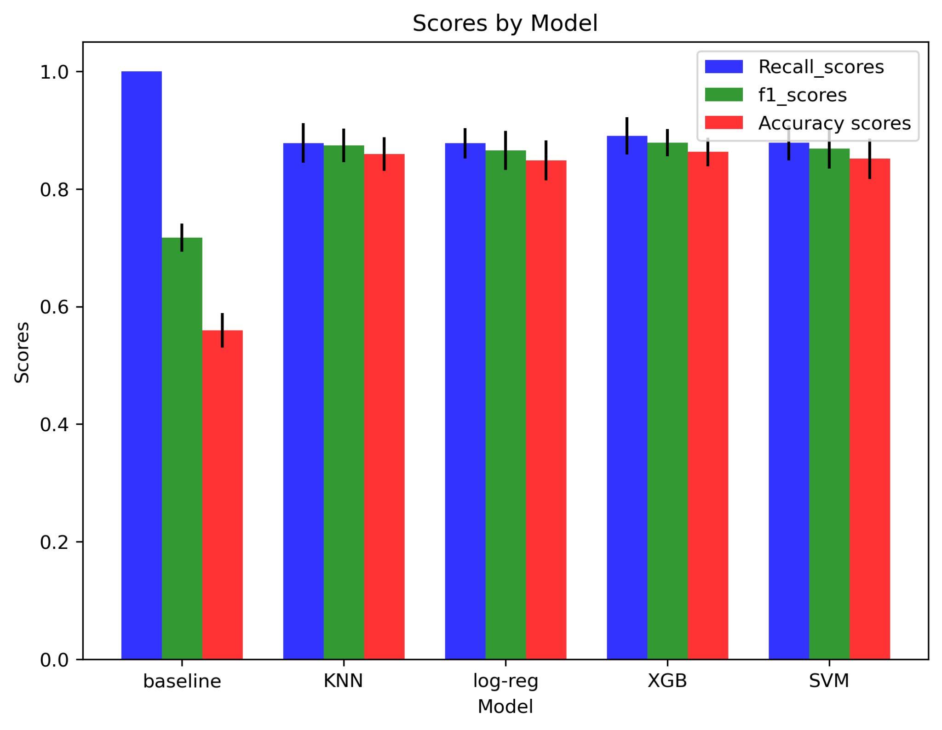
Results
Change in scoring metrics
XGBoost wins with f1 = [0.88]

Slide 6
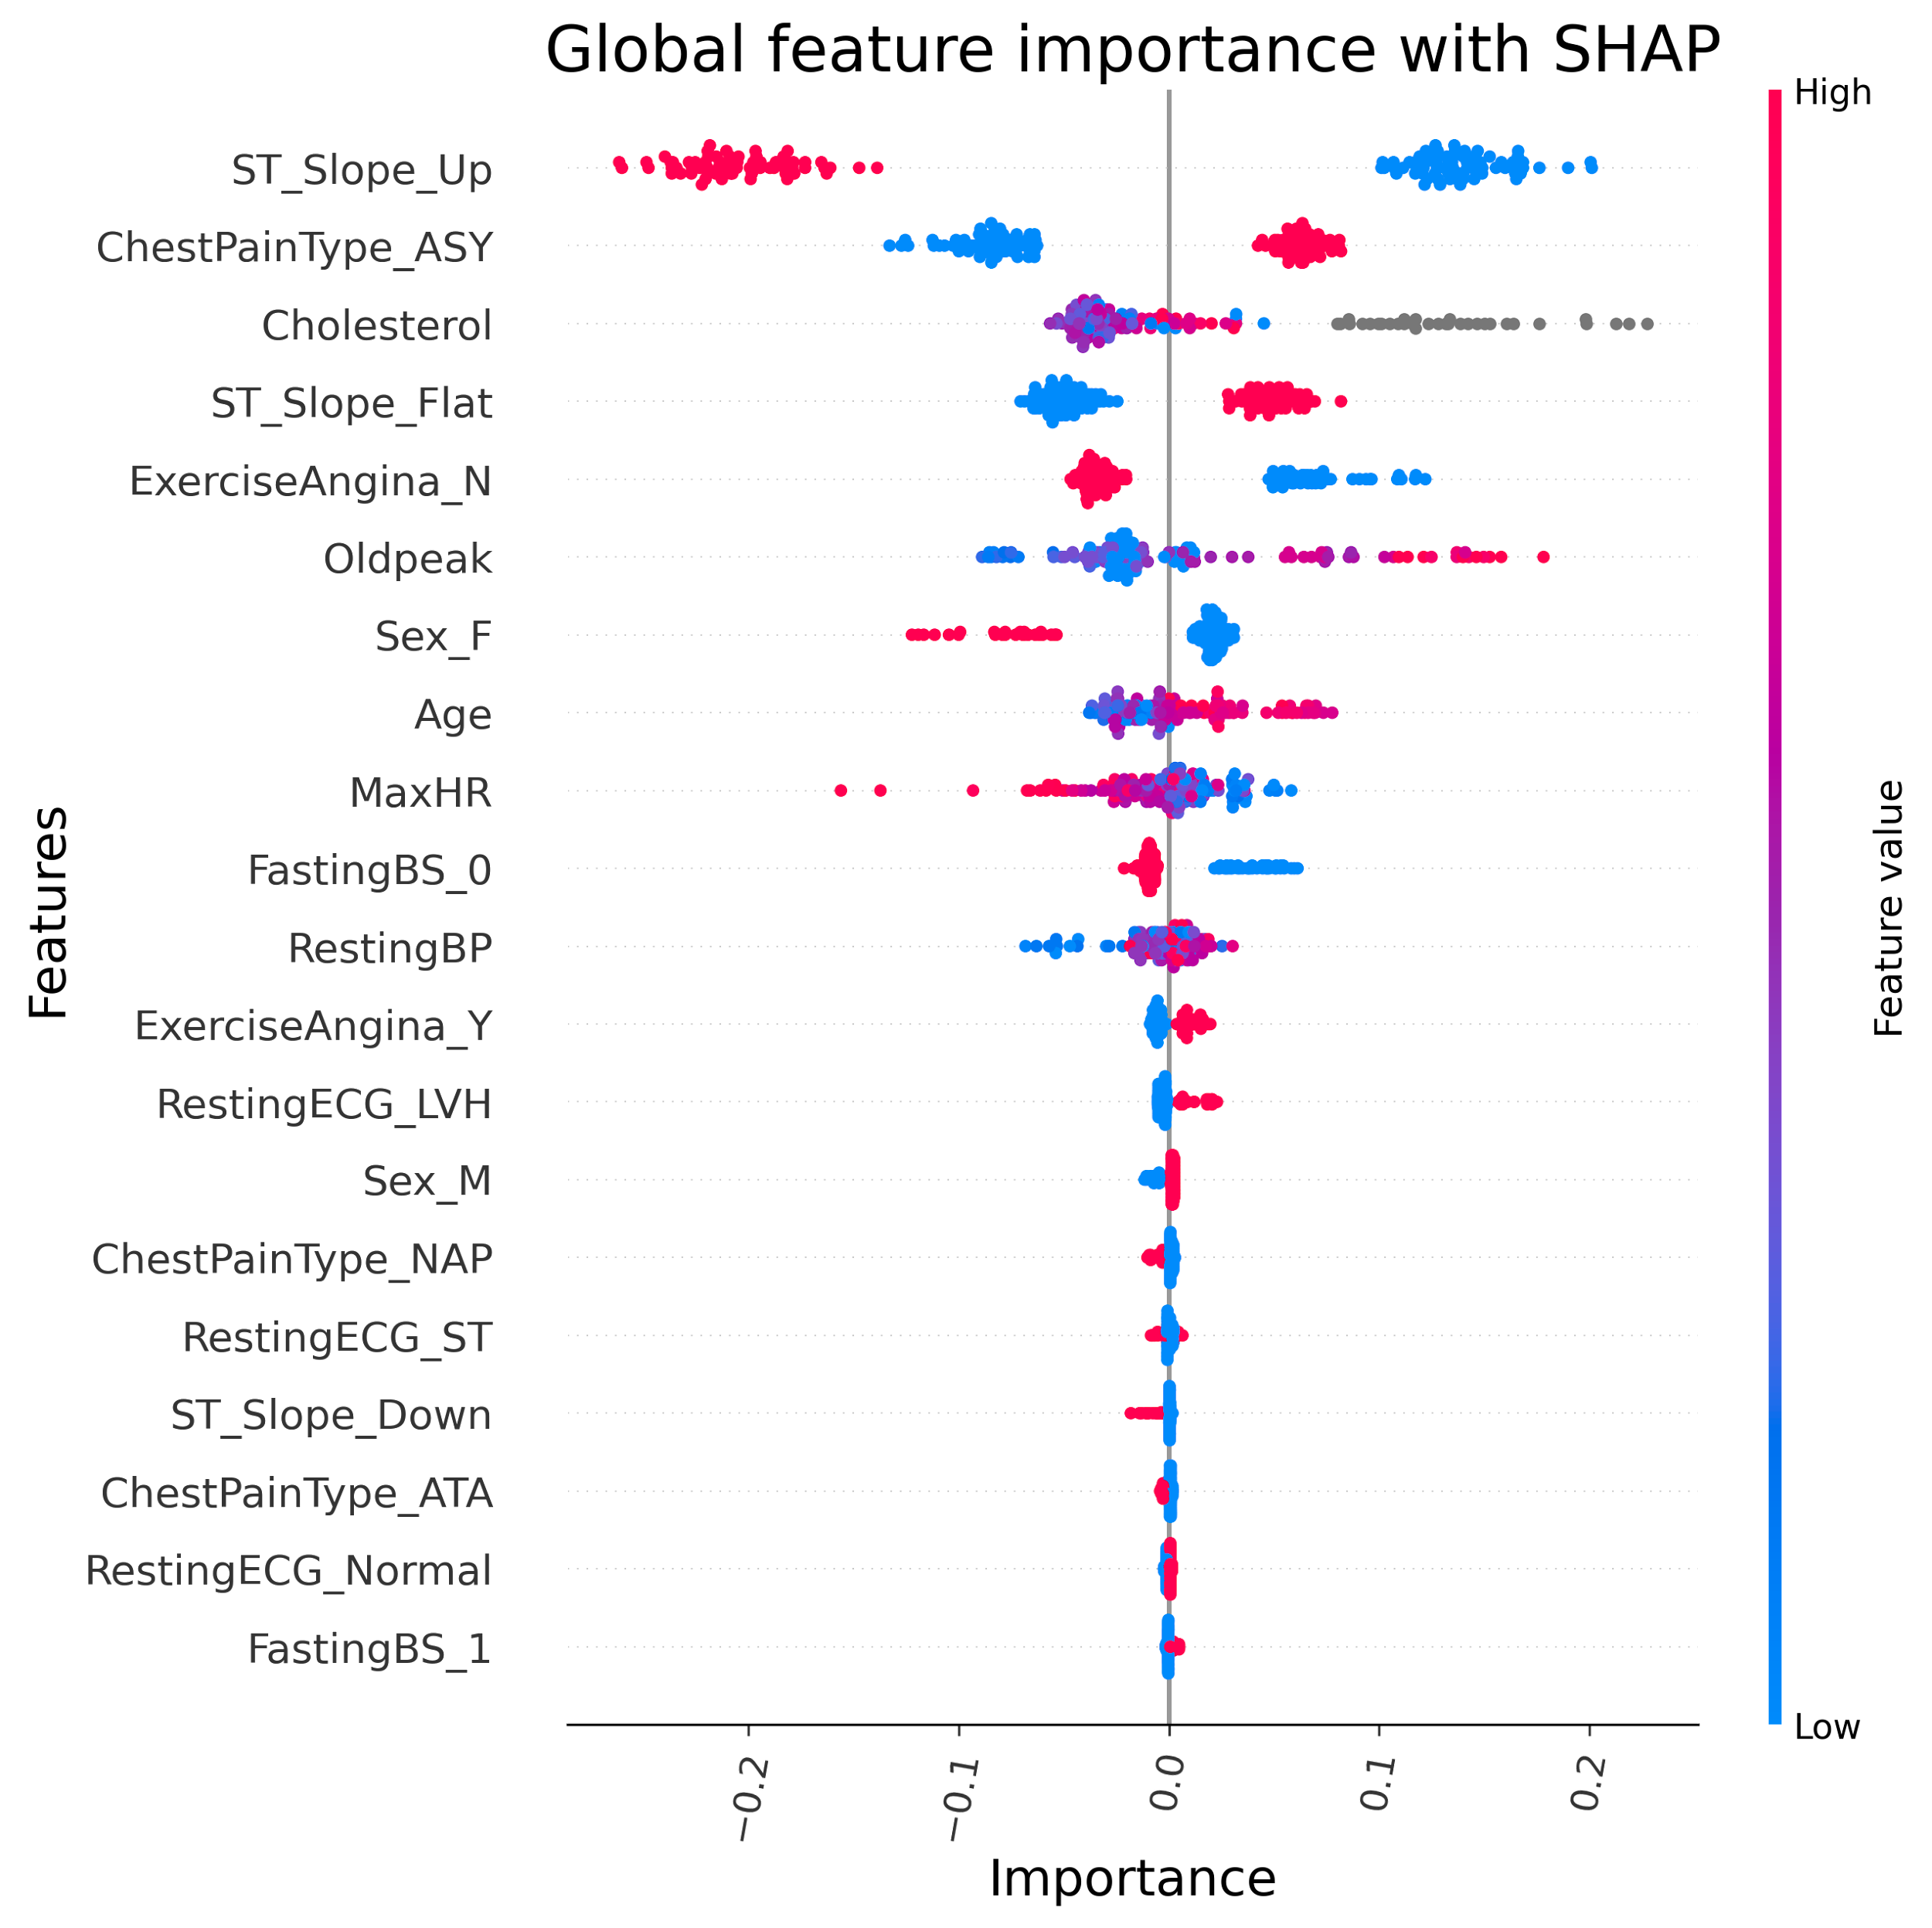
Results (feature importance)
Predictably,
Loosely defined man made metrics were important

Slide 7
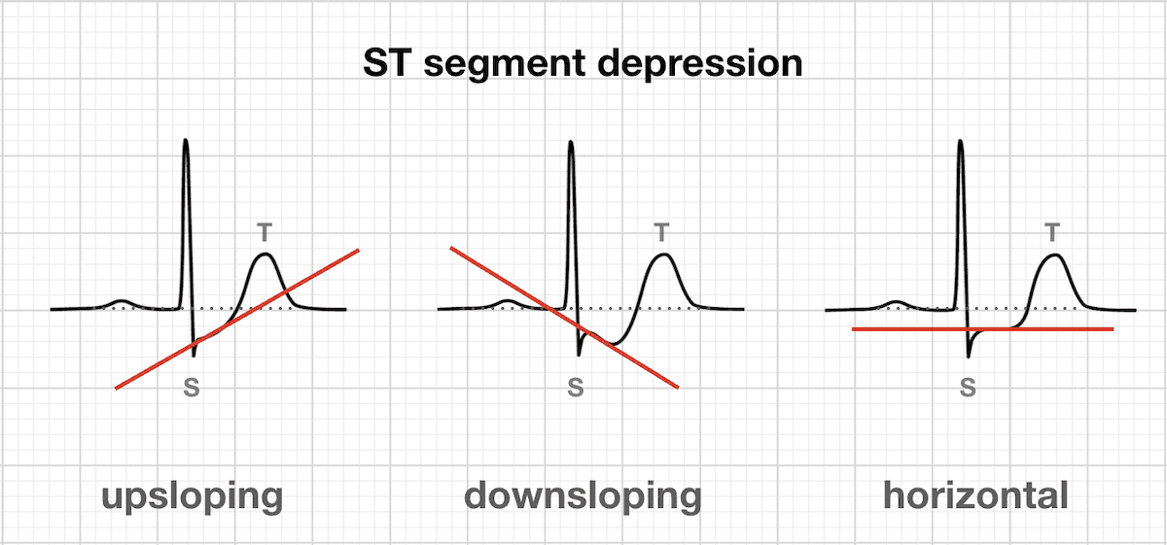
Outlook
Interpretability is really high - simple models perform well
Expanding on ST_Slope as it is the most predictive feature (see figure)
Furthermore signal interpretation could be a really useful model
Custom scoring metrics - controlling false alarm rate - would be application based
We know genetic data and health history would be useful

Slide 8
Questions?

